Slide 1
Cascading Style Sheet (CSS )
Language that describes the style of an HTML document and how HTML elements should be displayed
Notes:
http://www.w3schools.com/
https://www.codecademy.com/articles/html-inline-stylescss/css_syntax.asp

Slide 2
THREE WAYS TO APPLY CSS
INLINE CSS
by using the style attribute in HTML elements
INTERNAL CSS
by using a <style> element in the <head> section
EXTERNAL CSS
by using an external CSS file

Slide 3
EXAMPLE INLINE CSS
<p style=“color:green; background-color:yellow”> WELCOME </p>
EXAMPLE INTERNAL CSS
<head> <style>
p {color:green; background-color:yellow} </style></head>
<body>
<p> WELCOME </p>
</body>

Slide 4

INLINE CSS
Insert straight into the HTML tags using the style attribute.
HTML TAG
INLINE CSS
<p> Creating value with human-like robots </p>
<p style =“color:blue”> Creating value with human-like robots </p>

Slide 5
PRACTICE
Create a new web page in any text editor.
Name the page as robot.html
Insert 5 important tags in html document
Webpage title should be AI ROBOT
Copy content given inside Google Classroom

Slide 6
Applying INLINE CSS
add the style attribute to the selected tag
TEXT
Creating value with human-like robots

Slide 7
APPLYING CSS : INLINE STYLE SHEET
Change the text color for <h1> element to purple color
<h1>
style= “color:purple”>
Creating value with human-like robots
</h1>

Slide 8
APPLYING CSS : INLINE STYLE SHEET
Set the background color for <h1> element to linen color
<h1>
style= “color:purple
; background-color:linen”>
Creating value with human-like robots
</h1>

Slide 9
Applying INLINE CSS
add the style attribute to the selected tag
TEXT
Life-Inspired Intelligence

Slide 10
APPLYING CSS : INLINE STYLE SHEET
Change the text color for <h1> element to #808000
<h1>
style= “color :#808000>
Life-Inspired Intelligence
</h1>

Slide 11
APPLYING CSS : INLINE STYLE SHEET
Set the background color for <h1> element to #f5f5dc
<h1>
style= “color:#808000
; background-color:#f5f5dc”>
Life-Inspired Intelligence
</h1>

Slide 12
Applying Heading
Apply heading 2 to a selected tittle
TEXT
Sophia | Research & Custom Character Robot
Little Sophia | Consumer Robot
Han | Custom Character Robot
Zeno | Research Robot
Alice | Custom Character Robot
Professor Einstein | Consumer Robot

Slide 13
APPLYING CSS : INLINE STYLE SHEET
Change background color and text color for <h2> element
lavender
teal
<h2>
style= “color:teal
; background-color:lavender”>
Refer content inside your page
</h2>

Slide 14
APPLYING CSS : INLINE STYLE SHEET
Apply center alignment for ALL <h2> content
<h2>
style= “color:teal
; background-color:lavender
; text-align:center”>
Refer content inside your page
</h2>

Slide 15
APPLYING CSS : INLINE STYLE SHEET
Change h1 with your name. Apply for opening and closing tag
<ns
<h1
style= “color:#808000
; background-color:#f5f5dc”>
Life-Inspired Intelligence
</ns>
</h1>

Slide 16
APPLYING CSS : INLINE STYLE SHEET
Change back your name to h1. Apply for opening and closing tag
<ns
<h1
style= “color:#808000
; background-color:#f5f5dc”>
Life-Inspired Intelligence
</ns>
</h1>

Slide 17
APPLYING HTML : ORDERED LIST
<ol>
<li>
Sophia | Research and Custom Character Robot
Little Sophia | Consumer Robot
Han | Custom Character Robot
Zeno | Research Robot
Alice | Custom Character Robot
Professor Einstein | Consumer Robot
</li>
<li>
</li>
<li>
</li>
<li>
</li>
<li>
</li>
<li>
</li>
</ol>

Slide 18
APPLYING HTML : ORDERED LIST
Insert attribute type inside <ol>
<ol>
<ol type = “A”>
<li>
Sophia | Research and Custom Character Robot
Little Sophia | Consumer Robot
Han | Custom Character Robot
Zeno | Research Robot
Alice | Custom Character Robot
Professor Einstein | Consumer Robot
</li>
<li>
</li>
<li>
</li>
<li>
</li>
<li>
</li>
<li>
</li>
</ol>

Slide 19
APPLYING HTML : UNORDERED LIST
<ul>
<li>
</li>
Humanizing AI
Hanson AI Tools
Hanson AI Framework
Human-Like Animation
<li>
</li>
<li>
</li>
<li>
</li>
</ul>

Slide 20
APPLYING CSS : UNORDERED LIST
<ul>
style="list-style-image: url(url_for_icon) " >
<li>
</li>
Humanizing AI
Hanson AI Tools
Hanson AI Framework
Human-Like Animation
<li>
</li>
<li>
</li>
<li>
</li>
</ul>

Slide 21
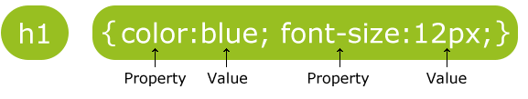
CSS SYNTAX
Selector
Declaration block
Selector: refers to the HTML element to be styled.
Declaration block:
surrounded by curly brackets { }
consist of declaration(s) separated by semicolons ;
A declaration: consist of a property name and a value, separated by a colon :

Slide 22
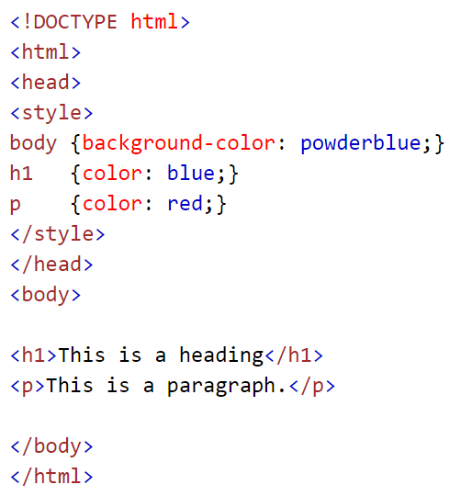

APPLYING CSS : INTERNAL STYLE SHEET
Suitable when a single document has a unique style
Definition at the head section in the HTML file

Slide 23
TYPE OF SELECTOR
CSS SELECTOR
p {
text-align : center;
color : red;
}
ID SELECTOR
#para1 {
text-align : center;
color : red;
}
CLASS SELECTOR
.center {
text-align : center;
color : red;
}

Slide 24

CSS SELECTORS
used to select and apply styles to page elements
can be an HTML tag / custom words
element selector selects elements based on the element name.

Slide 25
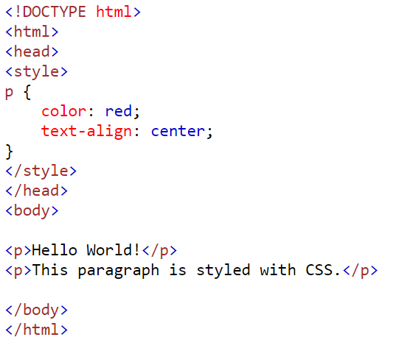

Slide 26
APPLYING CSS selector : INTERNAL CSS
<html > <head > <title> AI ROBOT</title>
<style>
body {background-color: whitesmoke}
</style> </head >
<body> TEXT as CONTENT HERE … </body>
</html>

Slide 27
APPLYING CSS selector : INTERNAL CSS
Change text color
<html > <head > <title> AI ROBOT</title>
<style>
body {background-color: whitesmoke;
</style> </head >
<body> TEXT as CONTENT HERE … </body>
</html>
color: steelblue }

Slide 28
APPLYING CSS selector : INTERNAL CSS
Change font face and alignment for <h1>
century gothic
center
<html > <head > <title> AI ROBOT</title><style>
body {background-color: whitesmoke; color: steelblue }
</style> </head >
<body> TEXT as CONTENT HERE … </body>
</html>
h1 {font-family: century gothic; text-align: center }

Slide 29
APPLYING CSS selector : INTERNAL CSS
For <h2>, change from Inline CSS to Internal CSS
<html > <head > <title> AI ROBOT</title><style>
body {background-color: smokepink; color: steelblue }
h1 {font-family: century gothic; text-align: center }
</style> <head > <body>
</body> </html>
<h2 style= “color:teal; background-color:lavender; text-align: center ”> Sophia | Research and Custom Character Robot </h2>

Slide 30
APPLYING CSS selector : INTERNAL CSS
For <h2>, change from Inline CSS to Internal CSS
<html > <head > <title> AI ROBOT</title><style>
body {background-color: lightpink; color: royalblue }
h1 {font-family: century gothic; text-align: center }
</style> <head >
<body>
</body>
</html>
h2 {color:teal; background-color:lavender; text-align: center }
<h2> Sophia | Research and Custom Character Robot </h2>

Slide 31
APPLYING CSS selector : INTERNAL CSS
Apply black font color for the word robot.
Use custom word yourname as the tag.
Apply in style tag
wahida {color:black}
Apply in body tag (apply for ALL word robot)
<wahida> robot </wahida>
Apply for robot, robots, and Robot

Slide 32



